Slide 1
Object Oriented Programming LAB # 02 In-Depth Understanding Of Classes and Objects
ENGR SANIYA SARIM

Slide 2
Basic Concepts Of OOP Object
An Object represents an entity either physical (box), conceptual (chemical process), or software (list).
An Object is a concept, an abstraction, a thing with sharp boundaries and meaning for an application. It has
Identity - a name
State - determined by the values of its attributes
Behavior - determined by how the object acts or reacts to requests (messages) from other objects

Slide 3
Class
A Class is a description of a group of objects with common properties (attributes), behavior (operations), relationships, and semantics
A class is an abstraction. An object is an instance of a class.

Slide 4
Example Of Class
Class: Course
Properties: Name, Location, Days Offered, Credit Hours, Professor
Behavior: Add Student, Delete Student, Get Course Roster, Determine If Full

Slide 5
Basic Concepts Of OOP
What is an Attribute?
An Attribute is a named property of a class. It has a type. It describes the range of values that that property may hold.
What is an Operation (Function)?
An Operation is a service that can be requested from any object of the Class to affect behavior. An Operation can either be a command or a question. A question should never change the state of the object only a command can. The outcome of the Operation depends on the current state of the object.

Slide 6
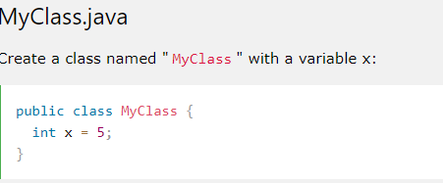
Create a Class
To create a class, use the keyword class:

Slide 7
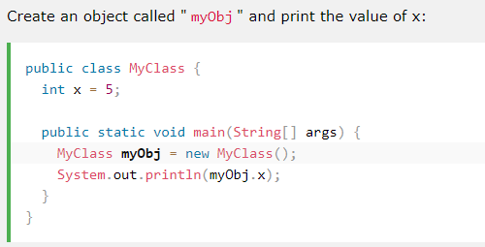
Create an Object
In Java, an object is created from a class. We have already created the class named MyClass, so now we can use this to create objects.
To create an object of MyClass, specify the class name, followed by the object name, and use the keyword new:

Slide 8
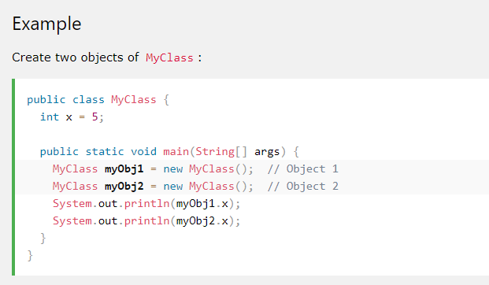
Multiple Objects
You can create multiple objects of one class:

Slide 9
Using Multiple Classes
You can also create an object of a class and access it in another class. This is often used for better organization of classes (one class has all the attributes and methods, while the other class holds the main() method (code to be executed)).
Remember that the name of the java file should match the class name. In this example, we have created two files in the same directory/folder:
MyClass.java
OtherClass.java

Slide 10
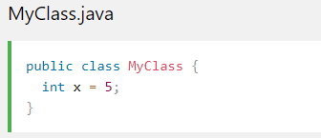
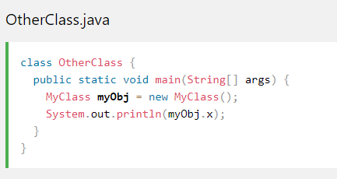
Multiple Classes

Slide 11
Exercise
Create an Animal class with name , speed and weight states and behaviours to change them and another that print that states. Create an AnimalDemo class that can be run as an application and create two objects of the Animal class.

Slide 12
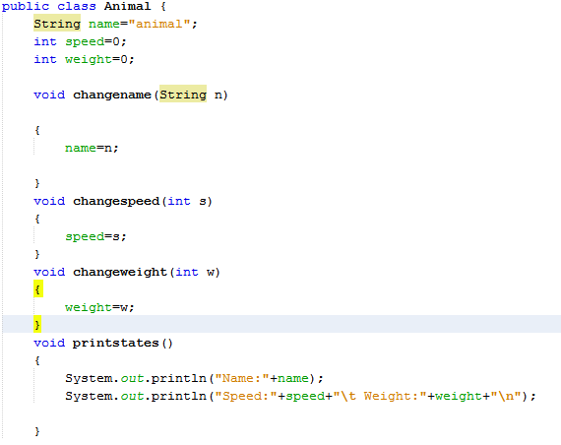
Animal Class

Slide 13
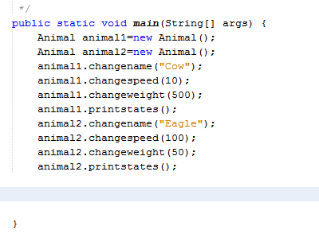
Animal Demo (Main Method)

